Slide 1
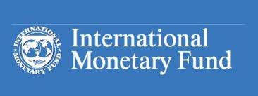
INTERNATIONAL MONATARY FUND
Dr. Srinibash Dash
Associate Professor & Head
School of Management
GMU, SBP

Slide 2
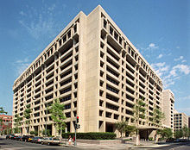
The International Monetary Fund (IMF) is an international organization.
Headquartered in Washington, D.C.
189 countries are the members of this organisation.
Working to foster global monetary cooperation, secure financial stability, facilitate international trade, promote high employment and sustainable economic growth, and reduce poverty around the world.“
Formed in 1944 at the Bretton Woods Conference primarily by the ideas of Harry White and John Keynes,
It came into formal existence in 1945 with 29 member countries and the goal of reconstructing the international payment system

Slide 3
Countries contribute funds to a pool through a quota system from which countries experiencing balance of payments problems can borrow money.
As of 2010, the fund had SDR476.8 billion, about US$755.7 billion at then exchange.
The organization's objectives stated in the Articles of Agreement are: to promote international monetary cooperation, international trade, high employment, exchange-rate stability, sustainable economic growth, and making resources available to member countries in financial difficulty

Slide 4
Functions
it works to foster global growth and economic stability by providing policy, advice and financing to members, by working with developing nations to help them achieve macroeconomic stability and reduce poverty.
its three primary functions were:
to oversee the fixed exchange rate arrangements between countries.
helping national governments manage their exchange rates and allowing these governments to prioritise economic growth.
to provide short-term capital to aid the balance of payments

Slide 5
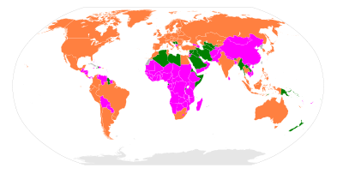
Surveillance of the global economy
The Fund typically analyzes the appropriateness of each member country’s economic and financial policies for achieving orderly economic growth, and assesses the consequences of these policies for other countries and for the global economy.

Slide 6
Conditionality of loans
The IMF requires in exchange for financial resources.
The IMF does require collateral from countries for loans but also requires the government seeking assistance to correct its macroeconomic imbalances in the form of policy reform.
If the conditions are not met, the funds are withheld.

Slide 7
Member countries
Not all member countries of the IMF are sovereign states, and therefore not all "member countries" of the IMF are members of the United Nations.
Qualifications
Any country may apply to be a part of the IMF. Post-IMF formation, in the early postwar period, rules for IMF membership were left relatively loose. Members needed to make periodic membership payments towards their quota, to refrain from rejection or denial.
The countries that joined the IMF between 1945 and 1971 agreed to keep their exchange rates secured at rates that could be adjusted only to correct the balance of payments, and only with the IMF's agreement.

Slide 8
Benefits
Member countries of the IMF have access to information on the economic policies of all member countries, the opportunity to influence other members’ economic policies, technical assistance in banking, fiscal affairs, and exchange matters, financial support in times of payment difficulties, and increased opportunities for trade and investment.^{[57]}

Slide 9
Criticisms
Developed countries were seen to have a more dominant role and control over less developed countries .
The Fund worked on the incorrect assumption that all payments disequilibria were caused domestically.
Some IMF policies may be anti-developmental
Lastly is the suggestion that the IMF's policies lack a clear economic rationale.

Slide 10
Thank you …
Any questions…??

